Slide 1
In the name of Allah, most gracious and merciful
Object Oriented Concepts &Design with Lab
Lecture – 1
Call by value/Reference

Slide 2
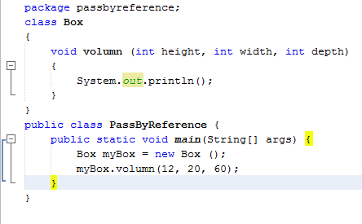
Method call by value

Slide 3
Method call by reference
Method will be called by parameterizing the reference.
Example:

Slide 4
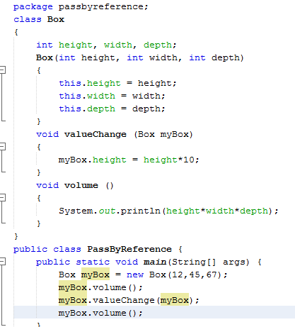

Slide 5
Declaring multiple classes
class A{
}
class B{
void M (A a)
{
}
}
Class Main{
public static void main(String[] args){
A a = new A( );
B b = new B( );
B.M(a);
}
}

